Slide 1


Slide 2
What is PGP
An encryption program that provides cryptographic privacy and authentication for data communication.
Used for signing, encrypting and decrypting texts, e-mails, files, directories, and whole disk partitions and to increase the security of e-mail communications.

Slide 3
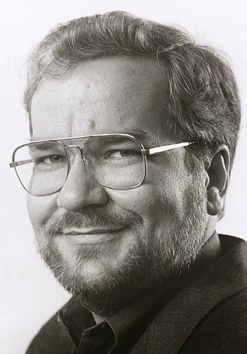
History
PGP was created by Phil Zimmermann in 1991 and that was the first version of PGP.
PGP found its way onto the internet and rapidly acquired a considerable following around the world.
In February 1993 Zimmermann became the formal target of a criminal investigation by the US Government for "munitions export without a license".
Notes:
At the time, cryptosystems using keys larger than 40 bits were considered munitions within the definition of the US export regulations; PGP has never used keys smaller than 128 bits, so it qualified at that time.

Slide 4
PGP 3 and founding of PGP Inc.
PGP 3
PGP INC
Have considerable security improvements, including a new certificate structure that fixed small security flaws in the PGP 2.X. Permitting a certificate to include separate keys for signing and encryption.
PGP 3 introduced the use of the CAST-128 symmetric key algorithm, and the DSA and El-Gamal asymmetric key algorithms, all of which were unencumbered by patents.
Merged with Viacrypt as Zimmermann had sold commercial rights, which then changed its name to PGP Incorporated.
The newly combined Viacrypt/PGP team started work on new versions of PGP encryption based on the PGP 3 system.
Unlike PGP 2, which was an exclusively command line program, PGP 3 was designed from the start as a software library allowing users to work from a command line or inside a GUI environment.

Slide 5
PGP fingerprint
A public key fingerprint is a shorter version of a public key. From a fingerprint, someone can validate the correct corresponding public key.
Can be printed on a business card

Slide 6
Compatibility
As PGP evolves, versions that support newer features and algorithms can create encrypted messages that older PGP systems cannot decrypt, even with a valid private key.
It is essential that partners in PGP communication understand each other's capabilities or at least agree on PGP settings.

Slide 7
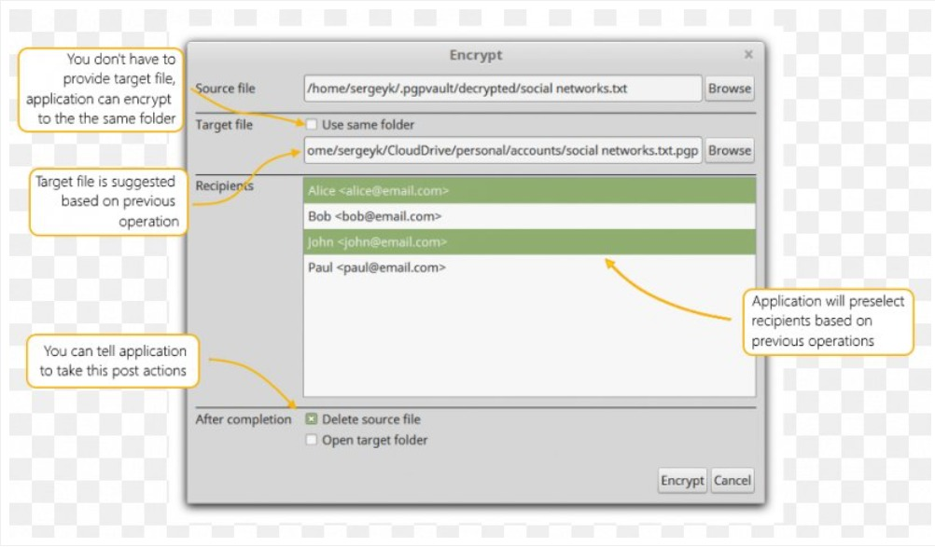
Software

Slide 8
Encryption
PGP uses a combination of symmetric key encryption (i.e., a single-use session key which encrypts and decrypts the message) and public key encryption (i.e., the keys unique to the recipient encrypt and decrypt the session key).
Before the process of encryption takes place, most PGP systems perform data compression. By compressing plaintext files prior to transmitting them, PGP saves both disk space and transmission time
The first thing PGP does is generate a random session key. This key is an enormous number that is used to encrypt and decrypt the contents of the message. This session key is also never used again for other messages it’s only for the single session.

Slide 9
Encryption
Next, the session key itself is encrypted using asymmetric encryption algorithm as RSA (1): the intended receiver (Bob) provides his public key to the sender of the message (Alice) so that she can encrypt the session key (2). This step allows Alice to safely share the session key with Bob through the Internet, regardless of security conditions.
Once the message's ciphertext and the encrypted session key are transmitted, Bob can use his private key to decrypt the session key, which is then used to decrypt the ciphertext back into the original plaintext.

Slide 10
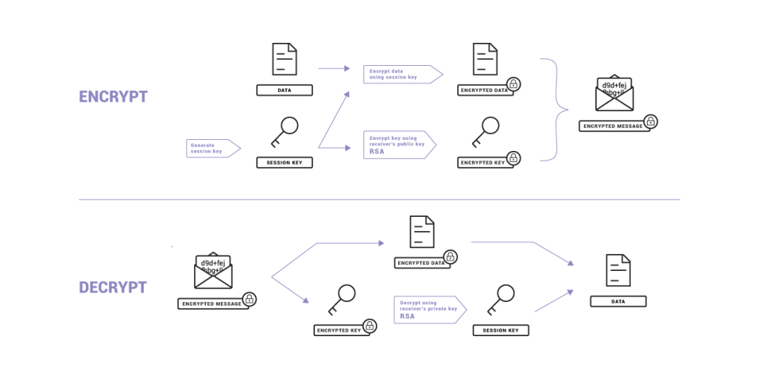

Slide 11
Why use two methods of encryption?
because public-key cryptography is much slower than symmetric cryptography, especially for large messages. So we use symmetric cryptography to encrypt and decrypt messages and we use public-key cryptography to encrypt and decrypt the session key that is used for more security

Slide 12
Advantages:
Very secure
PGP benefits from the security of asymmetric cryptography and the speed of symmetric encryption.
It is essentially unbreakable.
Available as free ware
Spread rapidly among users who wanted an extra level of security for their email messages
No compatibility problem
Works with any email application that you or you recipient is using. Can be applied in digital image, audio and video file

Slide 13
Advantages:
Provides authentication
Verify the sender information to ensure that you are not being fooled by a third party
Non recoverable messages
Cannot recover sensitive messages or files once you have deleted them.

Slide 14
Disadvantage
It is not user friendly
Can add significant extra work and time to your daily schedule.
No unknown users
You should be aware that PGP encrypts your messages, but it doesn’t make you anonymous

Slide 15
Disadvantage:
Complexity:
PGP is more complex, and it is less familiar than the traditional symmetric or asymmetric methods.
No Recovery:
PGP does not offer such a special program for recovery; encryption methods are very strong so, it does not retrieve the forgotten passwords results in lost messages or lost files

Slide 16
Is PGP encryption secure?
Yes. Though PGP is now more than 20 years old, there have been no weaknesses found in the basic implementation of the system so we can say that it is extremely safe, if used correctly and securely by individuals and organizations’ employees.
The encryption method uses algorithms that are considered unbreakable and is one of the most secure ways to protect data and cloud systems. Protecting data with PGP makes it effectively impossible to be intercepted by hackers.

Slide 17
When Do I need to use it?
It depends. If you are storing customer information, the answer is yes. Encrypting your personal files is not a necessity, but can dramatically improve your defenses against a cyberattack
PGP encryption can be a powerful tool in protecting your data, your privacy, and your security. It provides you with a relatively easy, completely secure method of sending emails, and also allows you to verify the identity of the people you are communicating with.

Slide 18
What is the best PGP software?
The “best” PGP software will depend on your needs. Most people don’t need to encrypt all of their emails, and so for most people a web-based PGP email provider will be the best solution. That said, if you are frequently sending emails that need to be encrypted, you can consider downloading a PGP add-on for your standard email client.
pfPgpEncryptor: it not only encrypts files, but it also compresses them at the same time. Plus, it also gives you complete freedom to select Hash and Encryption algorithms of your choice.
Kleopatra: it is a free open source PGP encryption software for Windows. Through this software, you can encrypt all of your important data, files, folders, etc.

Slide 19
Any Questions?

Slide 20
Mohamed Moghazy 19100650 Mina Bassem 19100337 Ahmed ezz 19101505

